Slide 1
CUSTOMER & PARTNER DECK · OCTOBER 2026
Turn any desktop computer
into a 3D metrology lab.
Precision 3D measurement, at cost.
An instrument maker and optical computation company. Reconstruction software, live today. A sealed measurement head on a desk stand, in design. One way to buy: a paid pilot, credited in full to an instrument built to order.
APERTUREAPI
For discussion · research use only

Slide 2
THE PROBLEM
Precision surface measurement
is a locked box with a queue.
One box, twenty people
No audit trail
Nothing in between
A profiler or interference microscope is shared by a department. The wait is one to three weeks and a re-measure costs a day.
Reconstruction lives inside the vendor's software or in someone's script. A result cannot be re-derived by a reviewer, an auditor or the next student.
Below the six-figure instrument there is a loupe and a scratch-dig card. Labs that cannot buy the box build nothing.
APERTUREAPI
02

Slide 3
WHAT WE ARE
An instrument maker and an
optical computation company.
I
II
III
The reconstruction kernel
The one product in development
The pilot, then the purchase
Live on the hosted API. An off-axis or inline hologram in; amplitude, phase and height out, with an evidence record that names the version, input and settings. Deterministic: same bytes every run.
The bench surface profiler: the H1 sealed reflection head on the D1 desk stand, built from catalog parts and a printed or purchasable enclosure. One sensor, one lens, one task. In design, not built. Inline head, transmission module and the optical computing card are portfolio, unpriced, after it qualifies.
A free bounded benchmark on your frames; $4,800 of milestone-paid pilot engineering (M1 build and bench acceptance, M2 signed readout), credited in full to the instrument; the unit built to order.
APERTUREAPI
Source: docs/gtm/src/39_paid_pilot_then_purchase.md
03

Slide 4
THE MARKET
Two ten-billion-dollar industries.
One instrument that fits on a desk.
~$10B
~$11.6B
At cost
MICROSCOPY
3D METROLOGY
OUR POSITION
labs, core facilities, biopharma,
semiconductor labs
manufacturing QA, aerospace,
electronics, metrology institutes
a complete head from catalog parts;
the value is the kernel, the
design and the pilot readout
APERTUREAPI
Source: docs/PATH_TO_300M_ARR.md (third-party 2024-25 estimates; market sizes only)
04

Slide 5
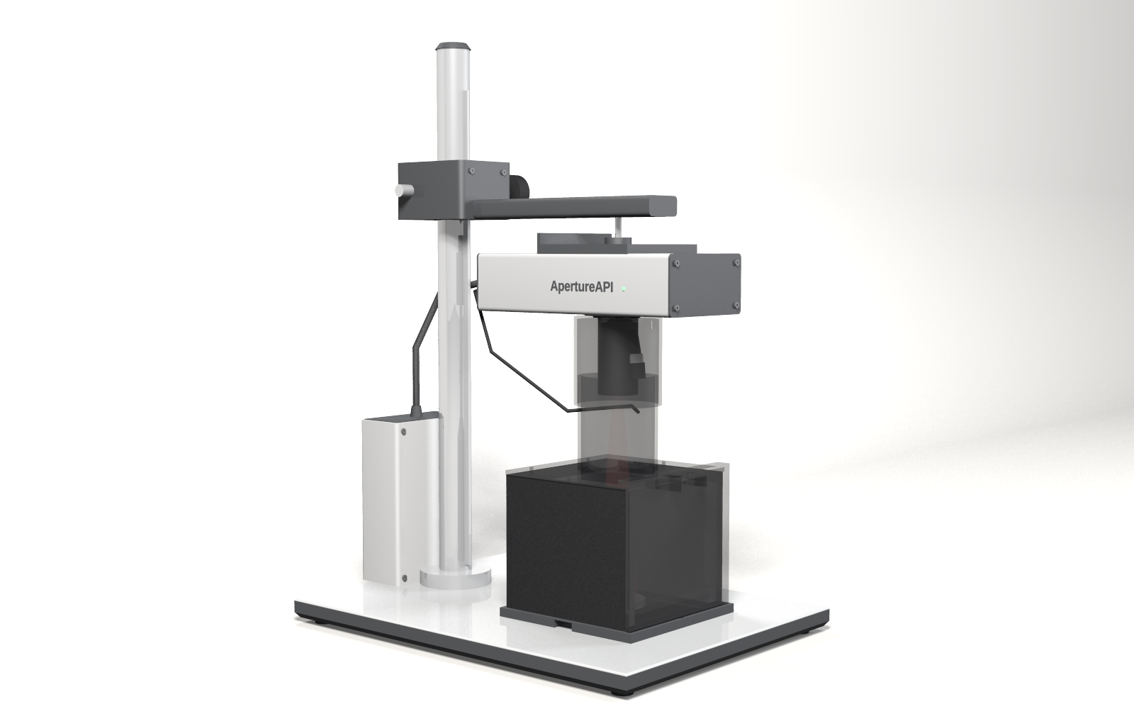
THE INSTRUMENT · FLEET V6 · H1 HEAD ON THE D1 STAND
One product
in development.
A sealed reflection head over a 150 x 150 mm stage behind a lift-off front door on a short column: a small drill press for light: the bench surface profiler, $12,900. Dock mode: a lensless dock clips under the head for polished and mirror-like parts (wafers, optics, flats), about 5.7 x 4.3 mm per shot at about 10 um lateral. Lens mode: a removable nose looks down at the stage and measures the form of matte, machined, printed, anodised or ceramic parts, about 50 x 39 mm at about 0.1 mm sampling; not a microscope. Height below a micrometre on smooth surfaces; rougher than about 0.16 um needs the second-wavelength option. Indoor light fine; window daylight with the shroud and its door seated; direct sun no. Designed as a Class 1 laser product in both modes: a four-sided light shroud with a lift-off front door; the laser enables only with door and back wall seated and nose or dock present. Catalog parts, no machining; designed so the operator runs the reference capture, a procedure to be timed on the first build. Every number is a design value.
CAD render, design values; front door, lid and light sleeve shown translucent for illustration; the laser is off whenever the door is open. Hardware qualification planned. Nothing built, nothing measured; every figure in the design files is a design value.
Portfolio, after the first product qualifies and unpriced until then: the same head on a belt flange (inline inspection head), the I1 transmission module, the optical computing card (research only).
Source: hardware/designs/fleet-v6-2026-10-29/DIRECTIVE.md (design values; nothing built or measured)
05

Slide 6
HOW TO BUY
Paid pilot, then purchase.
Not software by the token.
0
1
2
+
Free benchmark
Pilot engineering, $4,800
The instrument
Custom work
Up to about twenty of your frames, one reference, one pass/fail threshold agreed before we run, ten business days. $0.
Milestone-paid development, not a fee: M1 $2,400 on signing for build and bench acceptance of the demo configuration for your task; M2 $2,400 at the signed readout. Credited in full to the instrument.
The bench surface profiler, H1 head on the D1 stand, $12,900; second-wavelength option +$2,400. Software and ninety days of onboarding included. Fifty percent on order, balance on delivery. The one product in development; the portfolio is unpriced.
Design partnerships, $10,000 software or $25,000 hardware, for labs that need something built around them. Research and industrial-QA units: not certified, not medical.
Parts cost is a design value; the first unit has not been built; every price is an offer, not a quote book.
APERTUREAPI
Source: docs/gtm/src/39_paid_pilot_then_purchase.md
06

Slide 7
HOW WE ARE BUILT
Built without outside capital.
Built to order. Deposits fund units.
One demo unit
Deposits fund units
Parts you can buy
The first H1 head on its D1 stand is built from the founder's own capital. It is the pilot unit and the showroom. Nothing else is built until it is ordered.
Every further unit is built to order on a fifty percent deposit that exceeds its parts cost. No inventory, no hires, no conference budget, no loan.
Catalog sensor and source, a purchasable or printed enclosure, no machining. A lab can assemble its own; the price buys the pilot, the software and the onboarding.
Cost model: parts (design value) + founder engineering hours (to be timed on the first build) + calibration time + rework + support hours + patent prosecution (four nonprovisional applications, counsel) + commercial + hosting (unmeasured). Development cost is unproven until the first timed build; the price holds until then.
Incumbent benchtop profilers and lensed holographic microscopes list in the $40k to $150k+ class (approximate public list prices, to be verified): a price comparison, not a performance claim.
APERTUREAPI
Source: docs/gtm/src/39_paid_pilot_then_purchase.md
07

Slide 8
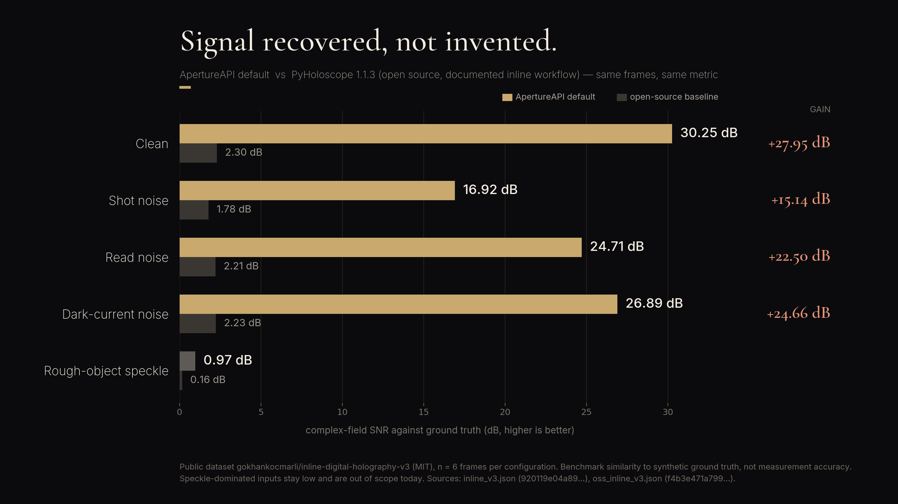
08

Slide 9
SPEED AND PROOF
Upload to a 3D view in seconds.
Every result carries its own evidence.
9.9 s
26.5 s
11 files
512 × 512, upload to 3D visualization mesh
1024 × 1024, typically under 30 s
in every result ZIP
median of 5 runs on the live API
median of 5; 2 of 9 runs on 10/13 exceeded 30 s
evidence record, provenance, quality report,
methods supplement, mesh, data
The mesh is a visualization, not a measurement. Reports keep reconstruction similarity, measurement accuracy and traceability on separate lines.
APERTUREAPI
Source: benchmarks/results/e2e_mesh_2026-10-14.json
09

Slide 10
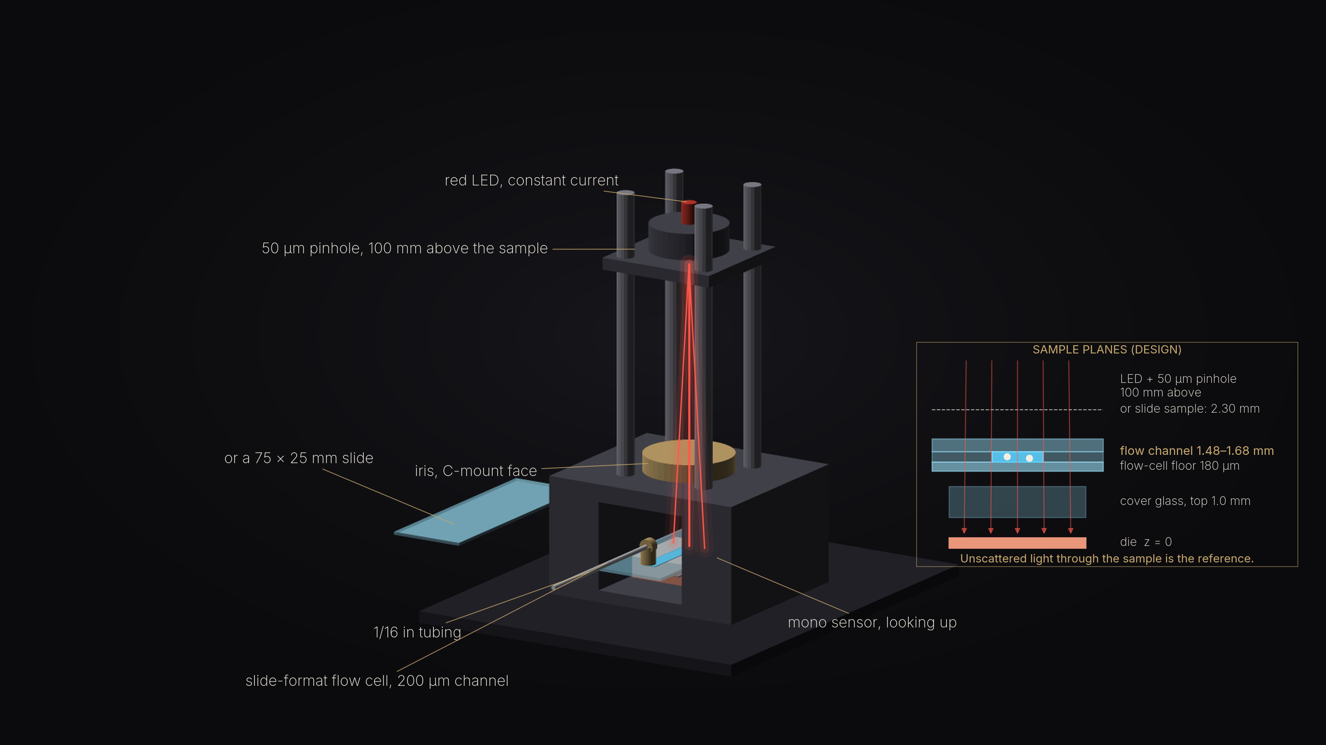
THE INSTRUMENT · I1 TRANSMISSION MODULE
Slide or flow cell, straight through the unit.
Lensless inline transmission for translucent samples: a fiber-fed source on one side of the sample, a mono sensor on the other. The light that passes the sample unscattered is the reference. A gap open at both ends takes a microscope slide or a slide-format microfluidic flow cell. Schematic from the M3 reference design, hardware/designs/m3-inline (chassis.scad, BUILD_PLAN v4.1, design_check.py); fleet v6 I1 lineage; not built.
10

Slide 11
WHAT IS MEASURED AND WHAT IS DESIGNED
Two columns we never mix.
MEASURED
DESIGNED, NOT MEASURED
The software is live, with determinism and a recomputable evidence record on every result.
Benchmark similarity on a public ground-truth set, with the result files committed.
Upload-to-mesh wall clock on the live API, median of five.
A closed-loop calibration example that is synthetic and labelled synthetic.
Every H1 and D1 number: field, working distance, resolution, room-light margin, parts cost.
Development cost: unproven until the first timed build; the price holds until then.
Accuracy against a physical reference: not established until a pilot measures it.
Any shipped instrument: none. Any frame rate: none quoted.
The P1 optical-computing card: research only, zero revenue in every plan.
APERTUREAPI
Source: docs/CANONICAL_FACTS.md
11

Slide 12
WHERE WE ARE
Live, honest, and early.
Live
Public API and a no-account upload form for evaluation; an evidence record on every result.
Designed
One product, the H1 head on the D1 stand: specs, parts lists and renders exist, the optics check passes, nothing built. Next spend: the fiber-fed core on a flat mirror, the one test that can kill it.
Gated
A nightly benchmark against public ground truth guards every release; a number goes public only with its result file committed; a claims gate refuses banned copy.
Early
Pre-revenue. One founder, built to order, no outside capital; the parent company covers payroll, legal and accounting; hosting costs $35 a month. Research use only.
APERTUREAPI
Source: docs/CANONICAL_FACTS.md
12

Slide 13
THE ASK
Two ways in.
RUN A PILOT
BUY THE BENCH PROFILER
$4,800
$12,900
Labs and QA benches with a surface-measurement task and a reference they trust. Milestone-paid pilot engineering: M1 $2,400 on signing, M2 $2,400 at the signed readout, both credited in full to the instrument you buy.
The H1 head on the D1 stand; second-wavelength option +$2,400. Built to order on a fifty percent deposit, software and ninety days of onboarding included. Parts cost is a design value; the first unit has not been built; the price is an offer.
APERTUREAPI
13

Slide 14
Precision 3D measurement, at cost.
apertureapi.com
Benchmark figures are similarity to synthetic ground truth, not measurement accuracy. Hardware figures are design values. ApertureAPI is a wholly owned subsidiary of Start Motion Media LLC.

